Slide 1


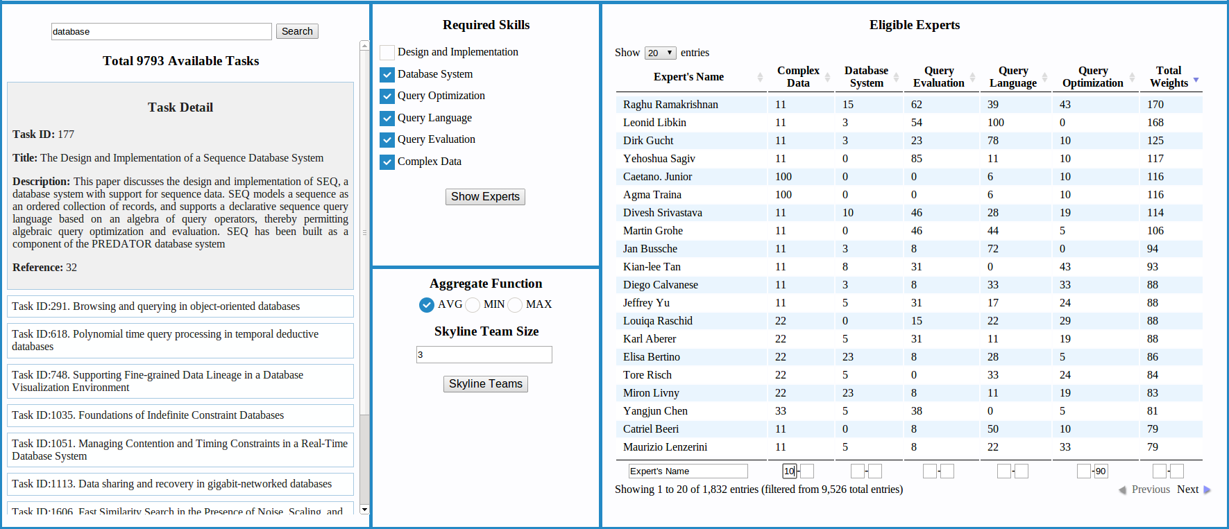
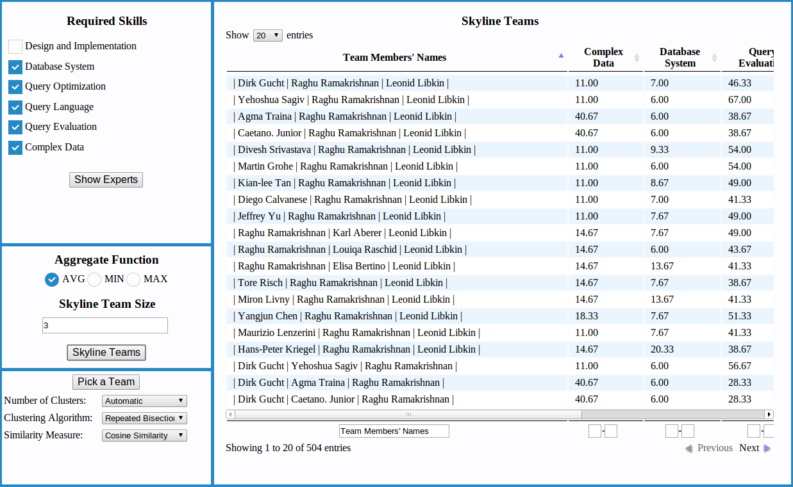




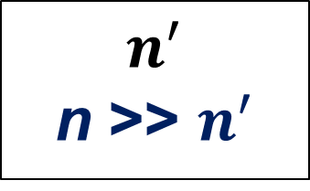

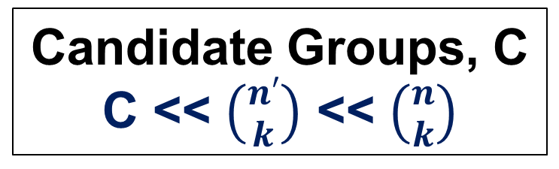
Anything You Can Do, I Can Do Better: Finding Expert Teams by CrewScout
Naeemul Hassan¹, Huadong Feng¹, Ramesh Venkataraman¹, Gautam Das¹, Chengkai Li¹, Nan Zhang²
¹University of Texas at Arlington, ²George Washington University
Motivation
Skyline Groups Problem
CrewScout Interface
Given a task that requires several different merits and objects with different scores on the merits, find a group of k objects with strong collective merits.
Several Motivating Applications
Crowdsourcing
Question-Answering platforms
Diverse product review selection
Fantasy games
Paper reviewer selection
 | Points | Assists | Blocks
P₁ | 30 | 14 | 5
P₂ | 40 | 12 | 3
P₃ | 40 | 15 | 3
P₄ | 20 | 11 | 2
P₅ | 40 | 11 | 2
 | AVG
 | Points | Assists | Blocks
P₁, P₂, P₃ | 37 | 13.7 | 3.7
P₁, P₂, P₄ | 30 | 12.3 | 3.3
P₁, P₂, P₅ | 37 | 12.3 | 3.3
P₁, P₃, P₄ | 30 | 13.3 | 3.3
P₁, P₃, P₅ | 37 | 13.3 | 3.3
P₁, P₄, P₅ | 30 | 12 | 3
P₂, P₃, P₄ | 33 | 12.7 | 2.7
P₂, P₃, P₅ | 40 | 12.7 | 2.7
P₂, P₄, P₅ | 33 | 11.3 | 2.3
P₃, P₄, P₅ | 33 | 12.3 | 2.3
Task Panel
Display Panel
Score of NBA players
Input
D: {P1, P2, P3, P4, P5}
k: 3
Aggregate function: AVG
Skyline Groups
{P1, P2, P3}, {P2, P3, P5}
Skill Panel
Score of Groups
Challenges
Visualization
Parameter Panel
Huge number of candidate groups: $\left({n \atop k}\right)$
Curse of Dimensionality may lead to many skyline groups
Visualizing all the skyline groups
Choosing preferred groups from many skyline groups
Clustering
Several similarity measures
Multiple clustering algorithms
Visualization
Size based on contribution to skyline groups
Force Layout
System Framework
Publications
n tuples
Group size k
Input Pruning
$$n^{′}$$
n >> $n^{′}$
On Skyline Groups. Li et al., ACM CIKM, November 2012.
On Skyline Groups. Zhang et al., IEEE TKDE, April 2014.
Anything You Can Do, I Can Do Better: Finding Expert Teams by CrewScout. Hassan et al., ACM CIKM, November 2014.
Search Space
Pruning
Clustering Parameters
Skyline Groups
Skyline Groups
Skyline
Operation
Candidate Groups, C
C << $\left({n′ \atop k}\right)$ << $\left({n \atop k}\right)$
Funding
idir.uta.edu/crewscout
Clustering
Visualization
Selection &
Filtering
Preferred Groups
Preferred Group Selection

